Slide 1

BitPredict: Predictive Analytics for Bitcoin
Inhouse Project
Final Review
Project Mentor : Dr. (Mrs.) Sujata Khedkar
Group Number : 11
Group Members :
Tithi Jhamnani D17B/31
Teesha Karotra D17B/33
Dimple Madhwani D17B/38
Aditi Salvi D17B/62

Slide 2
Content
Introduction to Project
Lacuna in the existing systems
Problem Definition
Literature Survey
Methodology employed
Hardware, Software, tools and the constraints
Block Diagram
Modular Diagram
Next Work Plan
Conclusion
References

Slide 3
Introduction to Project
The global financial landscape has seen a revolutionary boom in the popularity of cryptocurrencies in recent years, ushering in a new era of digital assets.
As the bitcoin market matures, the desire to realize its full potential has prompted researchers and traders to experiment with novel ways, the combination of Machine Learning (ML) and Artificial Intelligence (AI) with bitcoin trading has gotten a lot of interest in this area.
This study seeks to investigate the concept that apparent inefficiencies in the cryptocurrency market might be exploited to produce abnormal gains through the use of ML-assisted trading techniques.

Slide 4
Lacuna in the existing system
Current machine learning-based Bitcoin price prediction systems face a significant limitation in accurately foreseeing sudden market shocks and unforeseen events. They heavily rely on historical data, assuming a certain market behavior continuity, and struggle to adapt to abrupt changes like regulatory shifts or global economic events.
These unforeseen events can swiftly and profoundly impact cryptocurrency prices, making past data less reliable for future predictions.
The inherently volatile nature of the cryptocurrency market further complicates accurate forecasting.
This highlights the need for a more adaptable predictive framework that can incorporate real-time information and adjust to rapid market changes.

Slide 5
Problem Definition
Develop a deep learning model to predict the future price of Bitcoin based on historical market data, utilizing features such as trading volume, volatility, and macroeconomic indicators. The model should compare the efficacy of machine learning and deep learning models in predicting bitcoin prices in real time and aim to provide accurate short-term and long-term price forecasts, taking into consideration the inherent volatility of the cryptocurrency market.

Slide 6
Literature Survey
Authors | Paper Title | Contribution | Lacuna
Edwin Sin, Lipo Wang | Bitcoin Price Prediction Using Ensembles of Neural Networks | - Discusses the popularity of Artificial Neural Networks (ANNs) - Emphasizes the effectiveness of ensemble learning with neural networks. | -This paper mentions that ANN models outperformed traditional statistical models. However, it doesn't provide details of these traditional models or their comparative performance. - The paper mentions using approximately 200 features of Bitcoin over a span of 2 years for prediction. But doesn't delve into the features used or how these features were selected

Slide 7
Literature Survey
Authors | Paper Title | Contribution | Lacuna
Monish S, Mridul Mohta, Shanta Rangaswamy | Ethereum price prediction using Machine Learning Techniques– A Comparative Study | - Compares Ethereum prices predicted by three algorithms RNN, LSTM and Bidirectional LSTM. - The error metrics that were used to evaluate the results are MAPE, RMSE, MAE - They also conclude that short term prediction is more accurate than long term prediction. | - They used only one parameter for prediction i.e. ‘closing price’. - Accuracy can be further improved. - There is no details mentioned of the dataset used and its size.
Link to rest of the research paper’s survey

Slide 8
Methodology Employed
1. Data Collection: Gather historical Bitcoin market data, including price, volume, and relevant indicators, along with social media sentiment data for market sentiment analysis.
2. Data Preprocessing: Clean and prepare the collected data by handling missing values, outliers, and noise, and normalize or standardize numerical features for uniformity.
3. Feature Engineering: Create new meaningful features, such as rolling averages and volatility measures, to enhance the dataset's predictive power.
4. Feature Selection: Identify and choose the most impactful features for Bitcoin price movement using techniques like correlation analysis and machine learning model-based feature importance.
5. Model Selection: Opt for suitable deep learning algorithms like ARIMA, LSTM networks, Random Forest, Gradient Boosting, or combinations thereof for time series forecasting.
6. Model Training: Split the data, train the selected models, and fine-tune hyperparameters to achieve optimal performance, especially for deep learning models like LSTM.

Slide 9
Methodology Employed
7. Model Evaluation: Assess model performance using metrics like MAE, RMSE, or MAPE, and select the best-performing model based on evaluation results.
8. Hyperparameter Tuning: Fine-tune model hyperparameters using techniques like grid search or random search to further optimize performance.
9. Prediction and Testing: Utilize the trained model to make predictions on new data, and continuously monitor and retrain the model to adapt to changing market conditions.
10. Deployment: Implement the trained model in a real-time or batch prediction environment for ongoing price forecasting based on incoming data.
11. Monitoring and Maintenance: Continuously monitor model performance, retrain with fresh data, and update the methodology as needed to ensure accurate predictions in a dynamic market environment.

Slide 10
Hardware, Software, Tools and constraint
Hardware Tools Required
Processor: Intel i3 or AMD equivalent
Disk Space: 4GB
RAM: 8GB
Software Tools Required
Anaconda / Jupyter Notebook
Django Framework & Python
Matplotlib , seaborn, pandas , numpy
Google Colaboratory, Git & Github

Slide 11
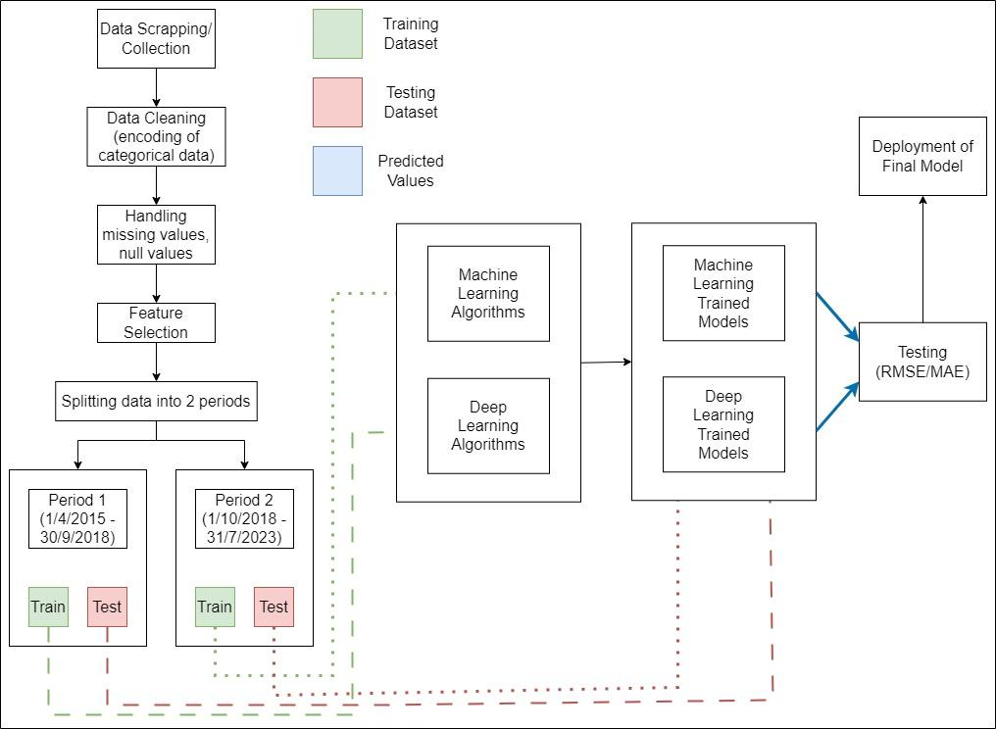
Block Diagram

Slide 12
Block Diagram
The first step is to scrape/collect data from online websites like coinmarket to create a Bitcoin dataset that will be used for analysis and prediction.
Next step is to clean out the dataset. It involves steps like encoding categorical values and handling missing and null values.
Next we select the features that are highly likely to give accurate analysis of the price of bitcoin.
The dataset is then split into 2 time periods. The time periods are as follows: 1/4/2015 - 30/9/2018 and 1/10/2018 - current date.
The data from the above two time periods is further divided into individual training and testing dataset.
The training dataset is then fitted into different Machine Learning and Deep Learning algorithms to obtain the trained model of each algorithm.
The test data is then fed into the trained models to obtain the predictions made by the models.
Then we evaluate the performance of each of these models to obtain the model with the highest accuracy and deploy it for future use.

Slide 13

Modular Diagram

Slide 14
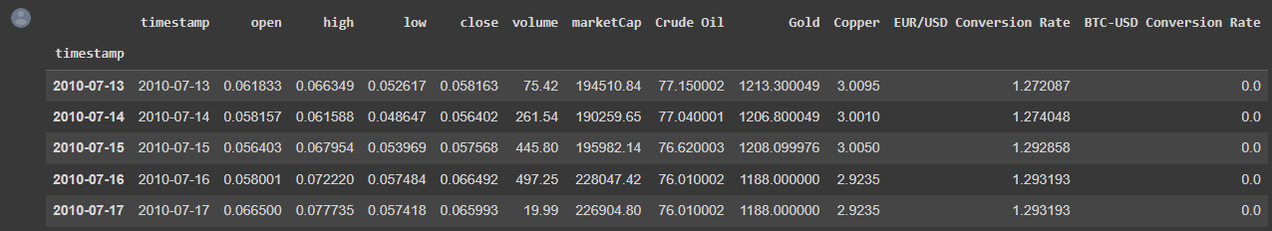
Implementation - Dataset (Sem 7)
open, high, low, close, volume - Daily OHLC values of Bitcoin are included in the dataset.
Market Cap - Daily Market Capitalization of Bitcoin is included.
Crude Oil, Gold Copper - Daily closing price of the respective metals (for weekdays) and Friday’s closing price (for weekends) is added to the dataset.
EUR/USD Conversion Rate - Daily Euro to US Dollars conversion rate is included.
BTC - USD Conversion Rate - Daily Bitcoin to US Dollars conversion rate is also included.

Slide 15
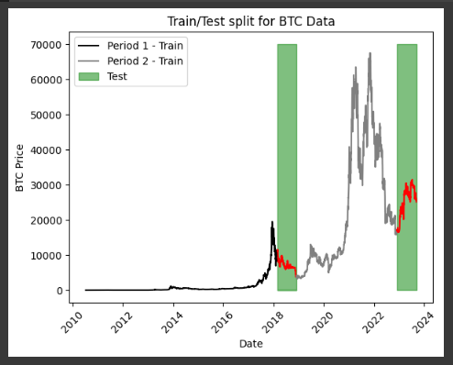
Implementation (Sem 7)

Slide 16
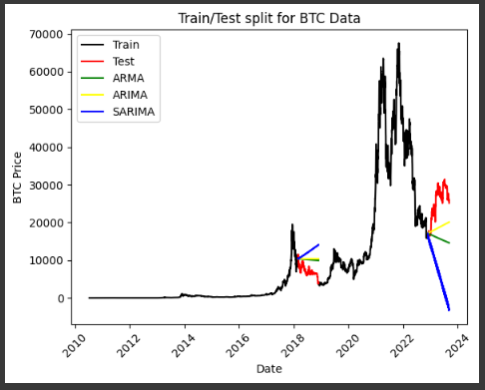
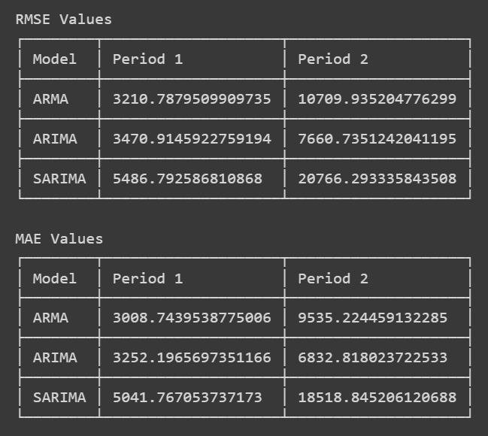
Implementation (Sem 7)

Slide 17
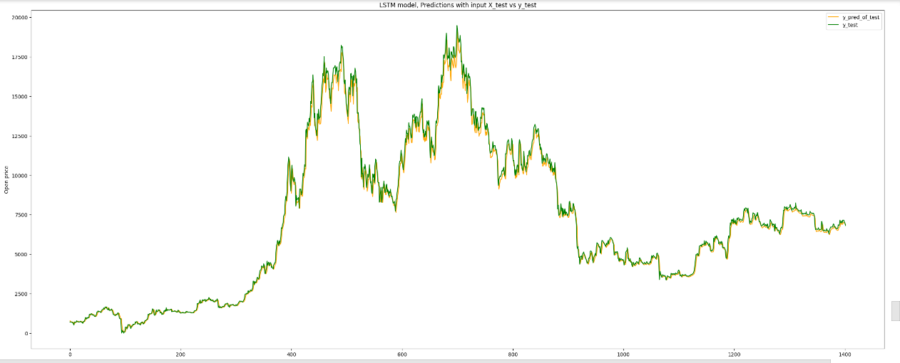
Implementation (Sem 7)
LSTM Model

Slide 18
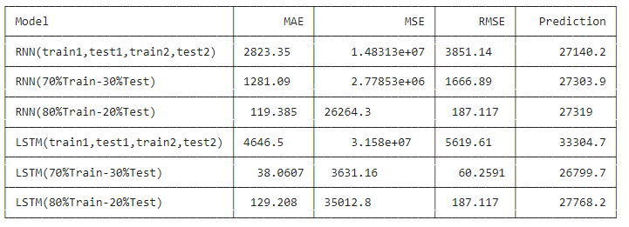
Implementation (Sem 7)
We have implemented RNN and LSTM model for 3 types of train-test data splits.
-> The entire time period is split into 2 parts namely period 1 and period 2, and then these periods are split into training and testing data.
-> The Data is split into 70% Train and 30% Test
-> The data is split into 80% Train and 20% Test
Comparison table with the features- Mean absolute error, mean squared error and root mean squared error

Slide 19
Implementation
Implemented deep learning models LSTM, GRU and RNN.
Implemented TimeGPT model
Forecasted Open, High, Low, Close values for n + 30 days for deep learning models and 5/10 day prediction for TimeGPT
Did the comparative study for each model build based on the evaluation metrics and found TimeGPT model more efficient.
Developed User Interface

Slide 20
Implementation
Comparison of models evaluation metrics
 | Open mae | Open mse | Open rmse | High mae | High mse | High rmse | Low mae | Low mse | Low rmse | Close mae | Close mse | Closermse
DL | 20712.45594 | 4.611689e+0 | 21474.84328 | 4696.519521 | 3.084378e+0 | 5553.717507 | 8492.220531 | 7.999569e+0 | 8944.030929 | 18261.41764 | 3.580819e+0 | 18923.05152
Tgpt5 | 3074.511833 | 1.629784e+0 | 4037.058935 | 2269.677309 | 9.614643e+0 | 3100.748858 | 1576.090656 | 3.964064e+0 | 1990.995839 | 2259.731488 | 9.688439e+0 | 3112.625817
Tgpt10 | 4509.594568 | 2.722772e+0 | 5218.018721 | 3640.235716 | 1.837546e+0 | 4286.660303 | 3982.825581 | 2.411822e+0 | 4911.030394 | 3859.006616 | 2.067696e+0 | 4547.192034

Slide 21
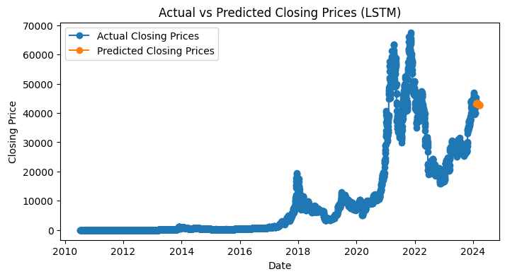
Implementation

Slide 22
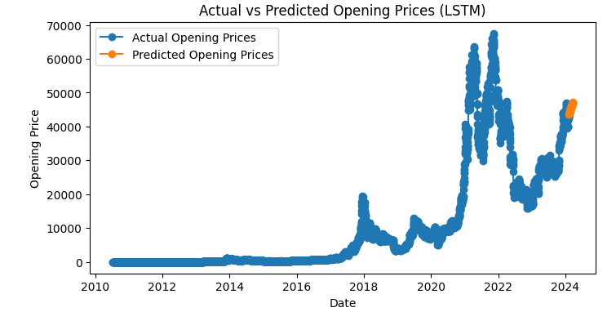
Implementation (LSTM)

Slide 23
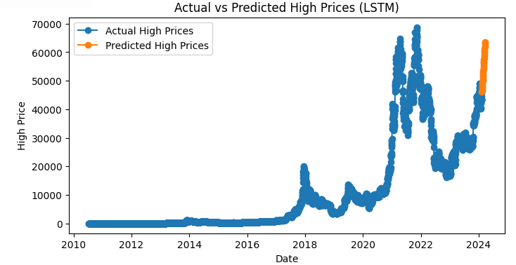
Implementation (LSTM)

Slide 24
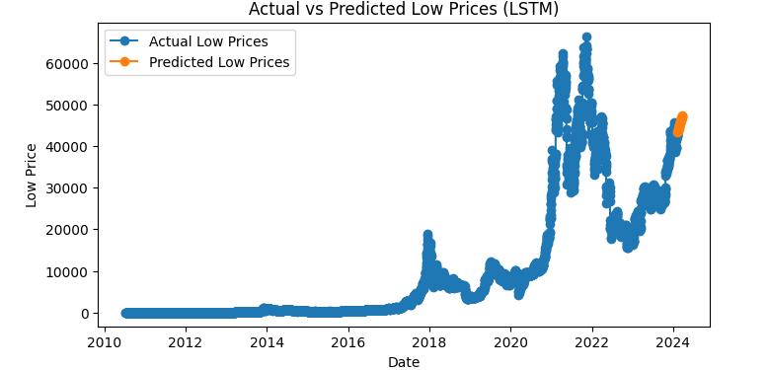
Implementation (LSTM)

Slide 25
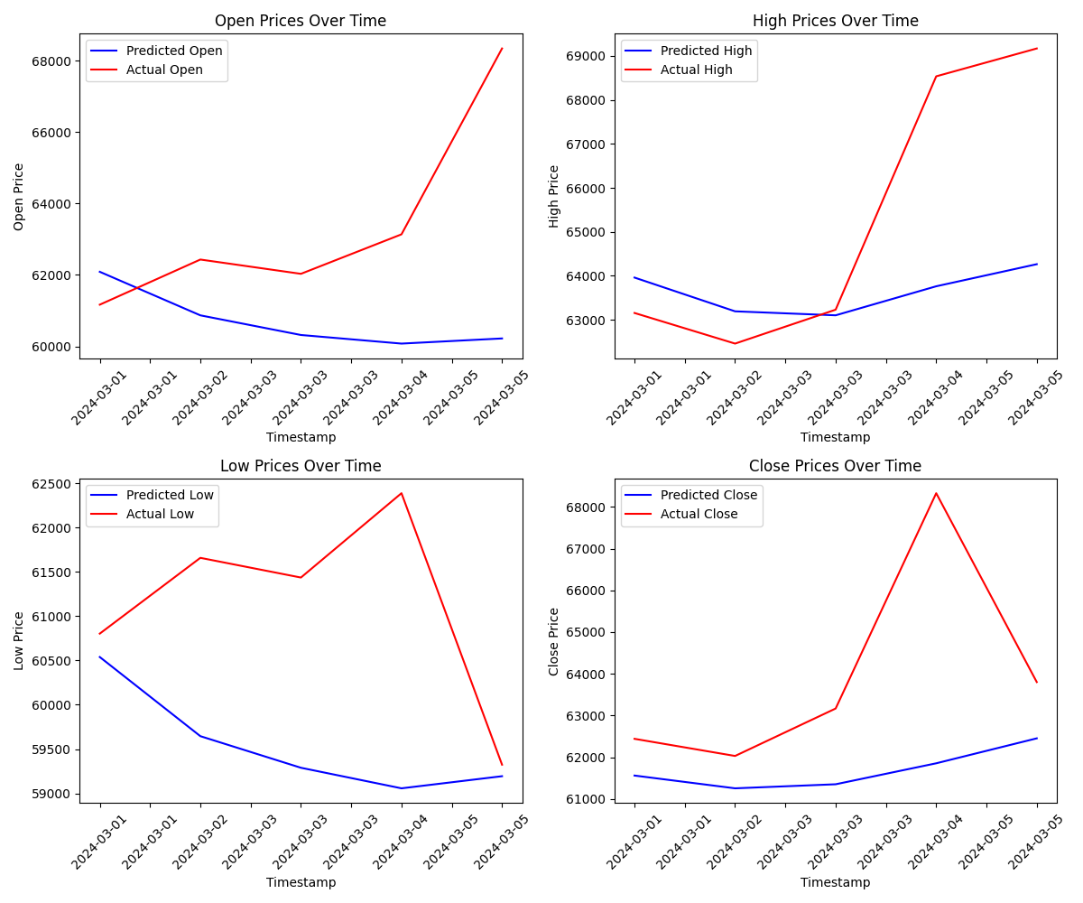
Implementation (TimeGPT 5 day)

Slide 26
Implementation (TimeGPT 10 day)

Slide 27
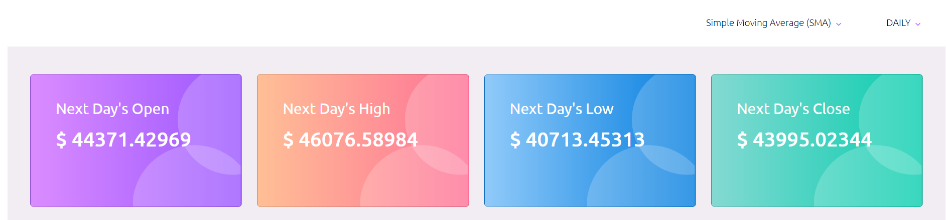
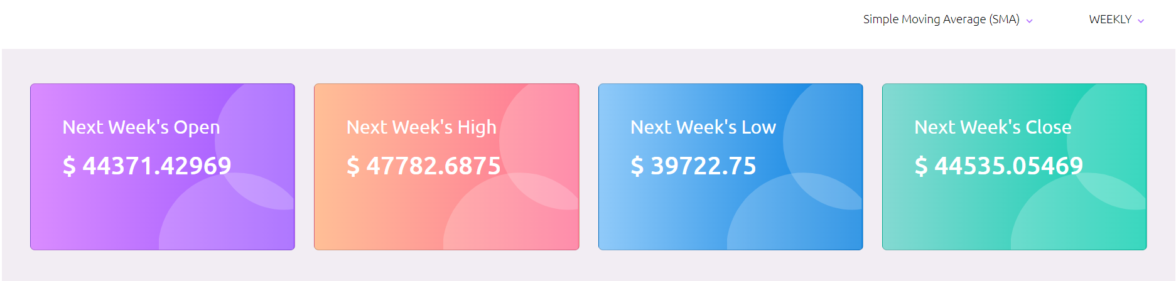
Implementation (UI of the system)

Slide 28
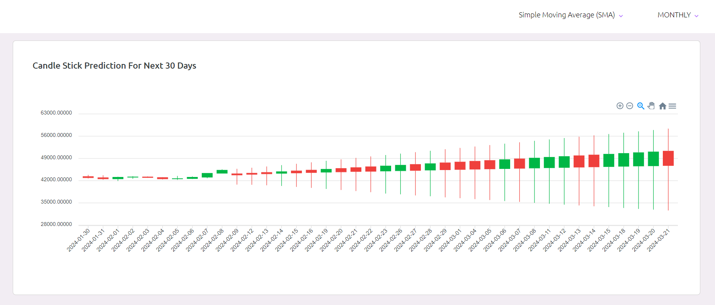
Implementation (UI of the system)

Slide 29
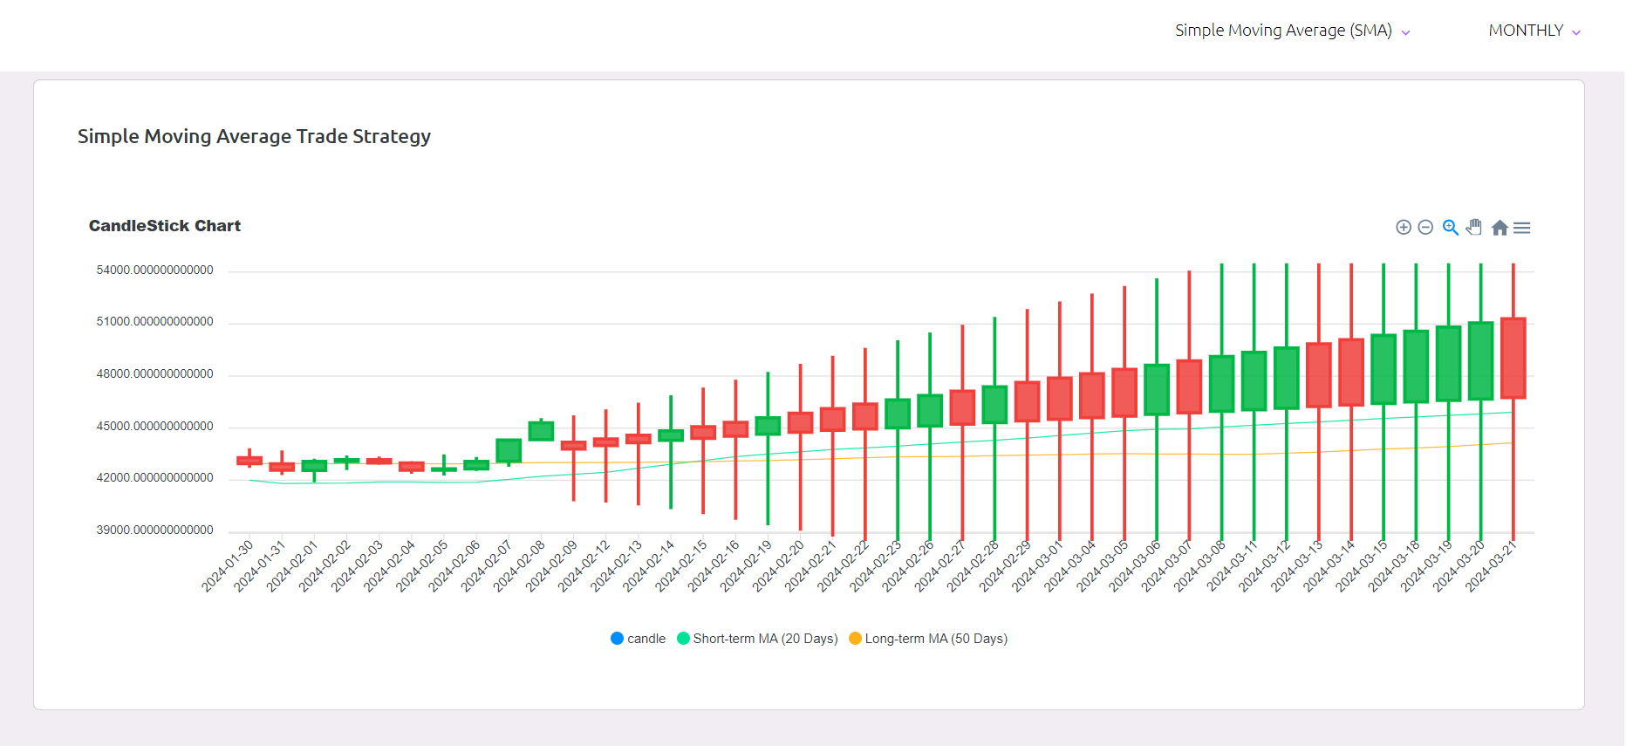
Implementation (UI of the system)

Slide 30
Future scope
Developing risk management tools for investors.
Continuously enhancing model accuracy and reliability.
Expanding to include other cryptocurrencies in portfolio optimization.
Integrating sentiment analysis from social media and news sources for improved market prediction.

Slide 31
Conclusion
The project will demonstrate the potential of deep learning in enhancing cryptocurrency trading strategies. By leveraging sophisticated algorithms and analyzing vast amounts of market data, the project will identify and exploit market inefficiencies, leading to abnormal profits. The results will highlight the importance of data-driven decision-making and the efficacy of machine learning and deep learning in navigating the complexities of the cryptocurrency market.As the cryptocurrency market continues its evolution, the insights gained from this project can serve as foundation for further advancements not only within cryptocurrency trading but also in algorithmic trading and financial analysis more broadly. The integration of deep learning techniques not only enhances the efficiency of trading strategies but also fosters a deeper understanding of market dynamics, paving the way for more informed investment decisions.

Slide 32
References
M. Rizwan, S. Narejo and M. Javed, "Bitcoin price prediction using Deep Learning Algorithm," 2019 13th International Conference on Mathematics, Actuarial Science, Computer Science and Statistics (MACS), Karachi, Pakistan, 2019, pp. 1-7, doi: 10.1109/MACS48846.2019.9024772.
Berend Jelmer Dirk Gort, Xiao-Yang Liu, Xinghang Sun, Jiechao Gao, Shuaiyu Chen, Christina Dan Wang (2022), Deep Reinforcement Learning for Cryptocurrency Trading: Practical Approach to Address Backtest Overfitting.
Monish S, Mridul Mohta, Shanta Rangaswamy, ETHEREUM PRICE PREDICTION USING MACHINE LEARNING TECHNIQUES – A COMPARATIVE STUDY, International Journal of Engineering Applied Sciences and Technology, 2022 Vol. 7, Issue 2, ISSN No. 2455-2143, Pages 137-142

